Slide 1

SciML in the DACS Lab
Raj Garkhedkar

Slide 2
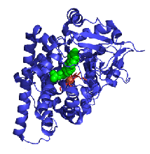
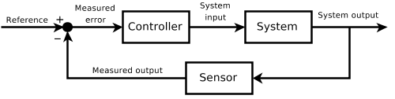
Background & Project Scope
Background:
Scientific machine learning (SciML) is the frontier for data driven model discovery
Overall Project – 3 phases:
Lorenz 63 System
Burgers & Korteweg – De Vries Equation
Wave Analysis
Disturbance!
Notes:
SciML is making strides in simplifying problems related to scientific computing - easing computation loads, discretizing high dimensional parameters into sparse matrices, data driven control of systems
Ex: protein structure simulations for geneticists – knowing the structure allows for site-directed injectable mutations to change functions of the protein
Ex: identify & manipulate a system to bring it back to control when disturbed. Like heating in a house.
Sensor monitors temperature in the home, controller compares the measured value with a reference value (the value we set on the thermostat). If the system is disturbed, a data driven controller would easily be able to compare the error against all other errors it’s been trained with, and can quickly identify a way to bring the system back to normal.
We know the inputs and we know the outputs, yet when a system behaves badly, we need robust & dynamic mathematical framework to bring it under control.
The first step is system identification – the parameters of the system must be measured, trained & implemented in a controller.
https://www.nature.com/articles/s41524-019-0221-0#Sec6

Slide 3
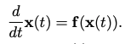
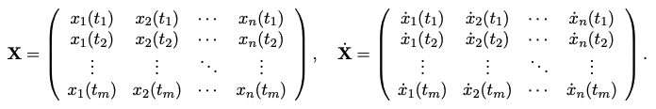
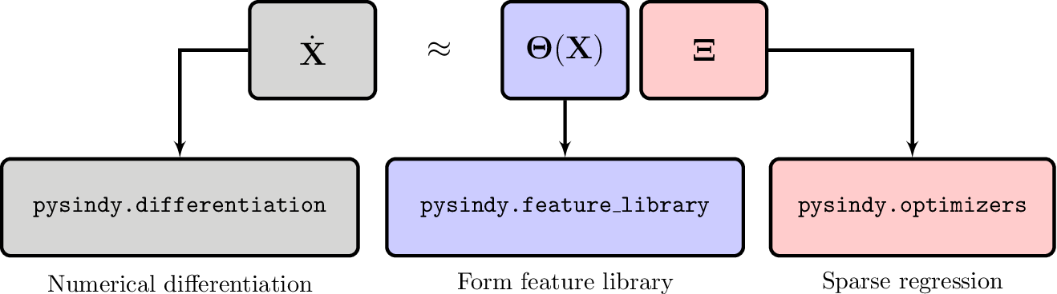
Info on PySINDy
SINDy – Sparse Identification of Nonlinear Dynamics
Identify the dynamics of the system via sparse regression methods
Notes:
For PySINDy, system identification poses model discovery as a sparse regression problem, where relevant terms in the dynamics are selected from a library of candidate functions, many of them motivated by our deep historical knowledge of diverse physics models. This approach results in interpretable models.
To pose SINDy as a regression problem, time-series measurements of x and their time derivatives x˙ are arranged into matrices. The function F describes how the state of the system evolves in time.
Feature library is the matrix containing all the time derivatives, Xi is a set of coefficients that determines the active terms in F. Xi does this through sparse regression algorithms.
To recap,
The numerical differentiation scheme used to approximate X˙ from X;
2. The candidate functions constituting the feature library Θ;
3. The sparse regression algorithm that is applied to solve (2) to find Ξ.

Slide 4
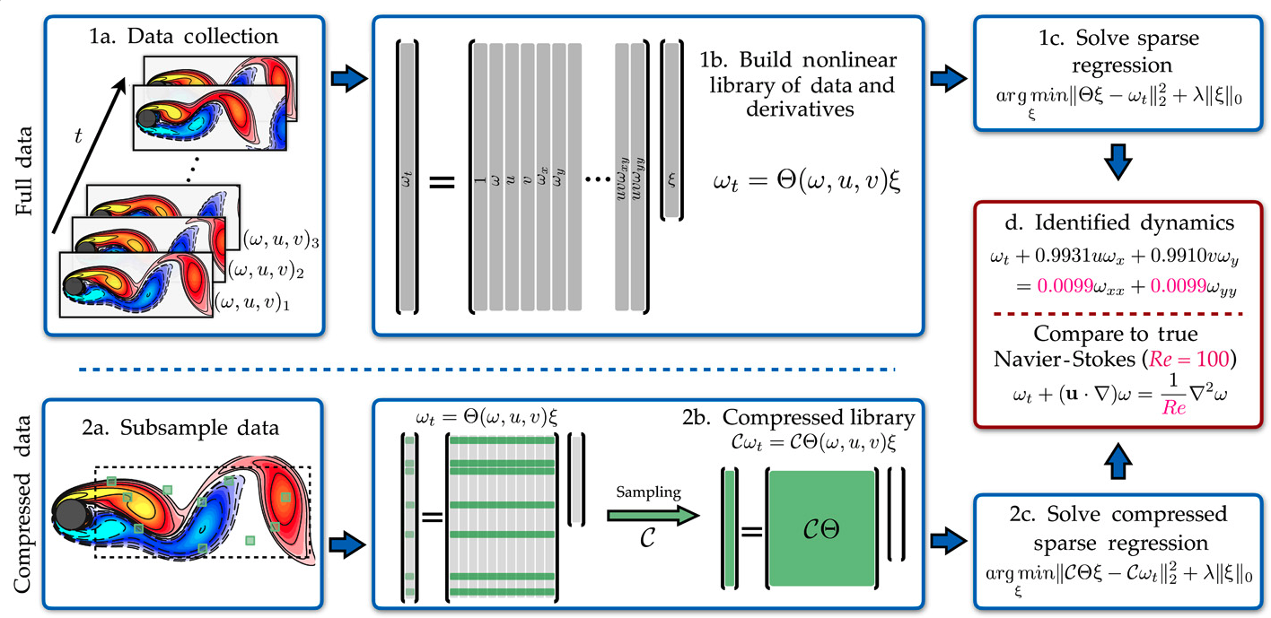
Info on PDE-FIND
Identify the dynamics of the system via sparse regression methods
Notes:
The work largely consists of ordinary and partial differential equations and various schemes to obtain potential solutions depending on the boundary conditions. Computationally intensive to solve – multi-rank tensors, large vector spaces. Like Tyrnan’s work on the Navier Stokes equations, numerical methods to solve are nearly impossible due to cascading effects for small changes to the particle’s velocity or pressure.
Coupled with the fact that they’re nonlinear in pretty much every situation, there could be tons of potential solutions – like 3 billion plus equations with unknown coefficients. The key is to form a sparse solution where we’re choosing the combinations of partial derivatives that contribute most to model accuracy – like 5 for example, we’d be finding 5 of the most influential low order partial derivatives out of the potential candidate solutions, through creating a sparse representation of 210 or so candidate combinations of partial derivatives.
Data fed in consisting of state measurements. which describes how the system evolves in time by approximating candidate functions.
(1a) Data is collected as snapshots of a solution to a PDE. (1b) Numerical derivatives are taken, and data are compiled into a large matrix Θ, incorporating candidate terms for the PDE. (1c) Sparse regressions are used to identify active terms in the PDE. (2a) For large data sets, sparse sampling may be used to reduce the size of the problem. (2b) Subsampling the data set is equivalent to taking a subset of rows from the linear system in Eq. 2. (2c) An identical sparse regression problem is formed but with fewer rows. (d) Active terms in ξ are synthesized into a PDE.

Slide 5
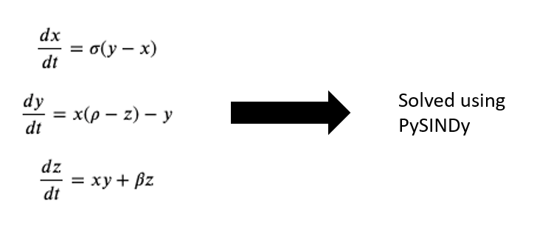
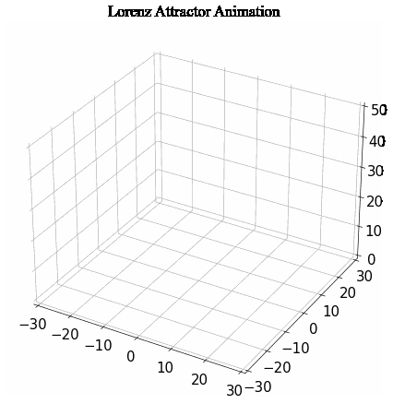
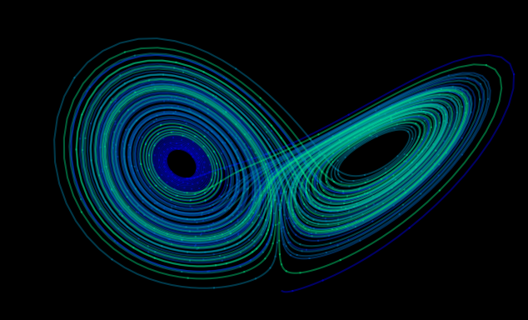
Phase 1: Lorenz 63 Oscillator
Notes:
A way to identify the dynamics of the Lorenz system, a system of chaos
Used PySINDy library to form the sparse matrix to show the evolution and parameters which contribute greatest to the system evolution.
Depending on the initial conditions and boundary conditions of the differential equations
A deterministic equation, meaning that if we know the initial conditions, we can predict the state of the system at the next incremental time.
Useful for identifying properties of a two dimensional fluid layer uniformly warmed from above and cooled from below. The equations describe the rate of change of change of the parameters.
Basically, modeling a system of convective flow showing the motion of particles induced by heat.
This chaotic system is used for weather prediction, modeling the convection in Earth’s atmosphere.

Slide 6
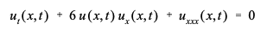
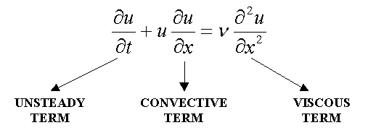
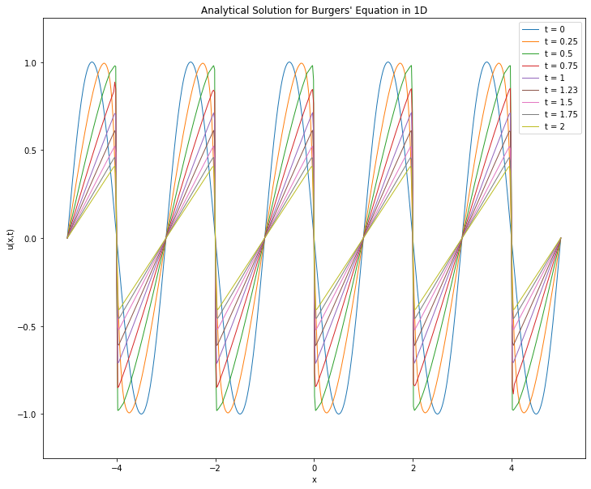
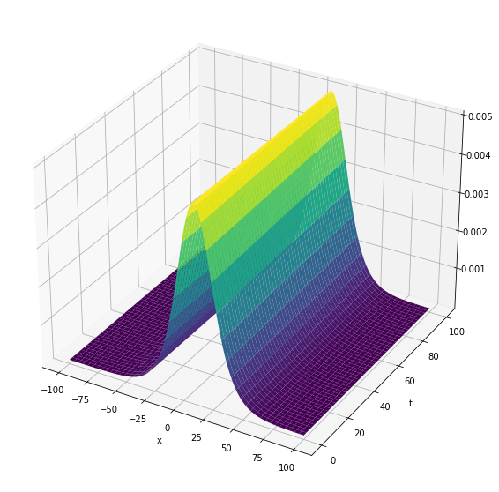
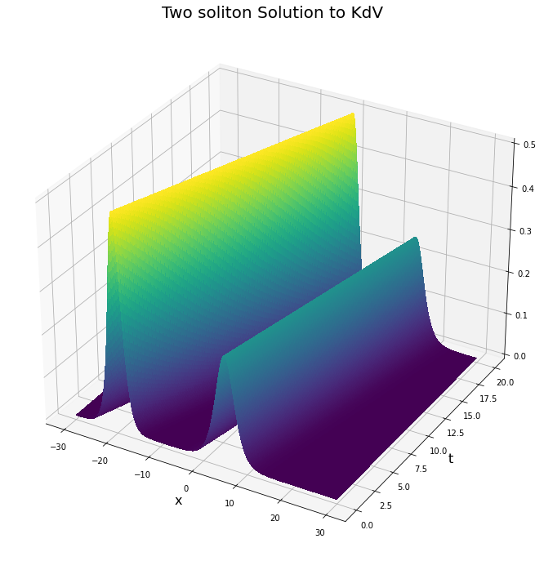
Phase 2: Korteweg-De Vries & Burgers Equation
Solved w/ PDE-FIND
Notes:
KdV equation is a model for waves on shallow water surfaces, is a topic of active research currently. There can be dissipative terms to show how the wave evolves and dissipates as well as collides with other waves.
nonlinear because of the product shown in the second summand and which is of third order because of the third derivative as highest in the third summand. The factor 6 is just a scaling factorBurgers equation is similar but broader, ubiquitous in fluid mechanics, acoustics, gas dynamics, and shock waves. The solutions are called solitons or solitary waves
The system can be modified to calculate the momentum and energy transfers & interactions
Other applications include modeling internal waves in a ‘densely stratified ocean’ , acoustic waves in plasma, acoustic waves in a crystal lattice – huge topic in material science & condensed matter physics.
Burgers Eq:
Describes a moving viscous fluid with a spatial and temporal dimension – like a pipe with fluid running through it, the equation would describe the speed of the fluid along each location along the pipe as time progresses
Viscous and stochastic terms can be added depending on the physical system at hand

Slide 7
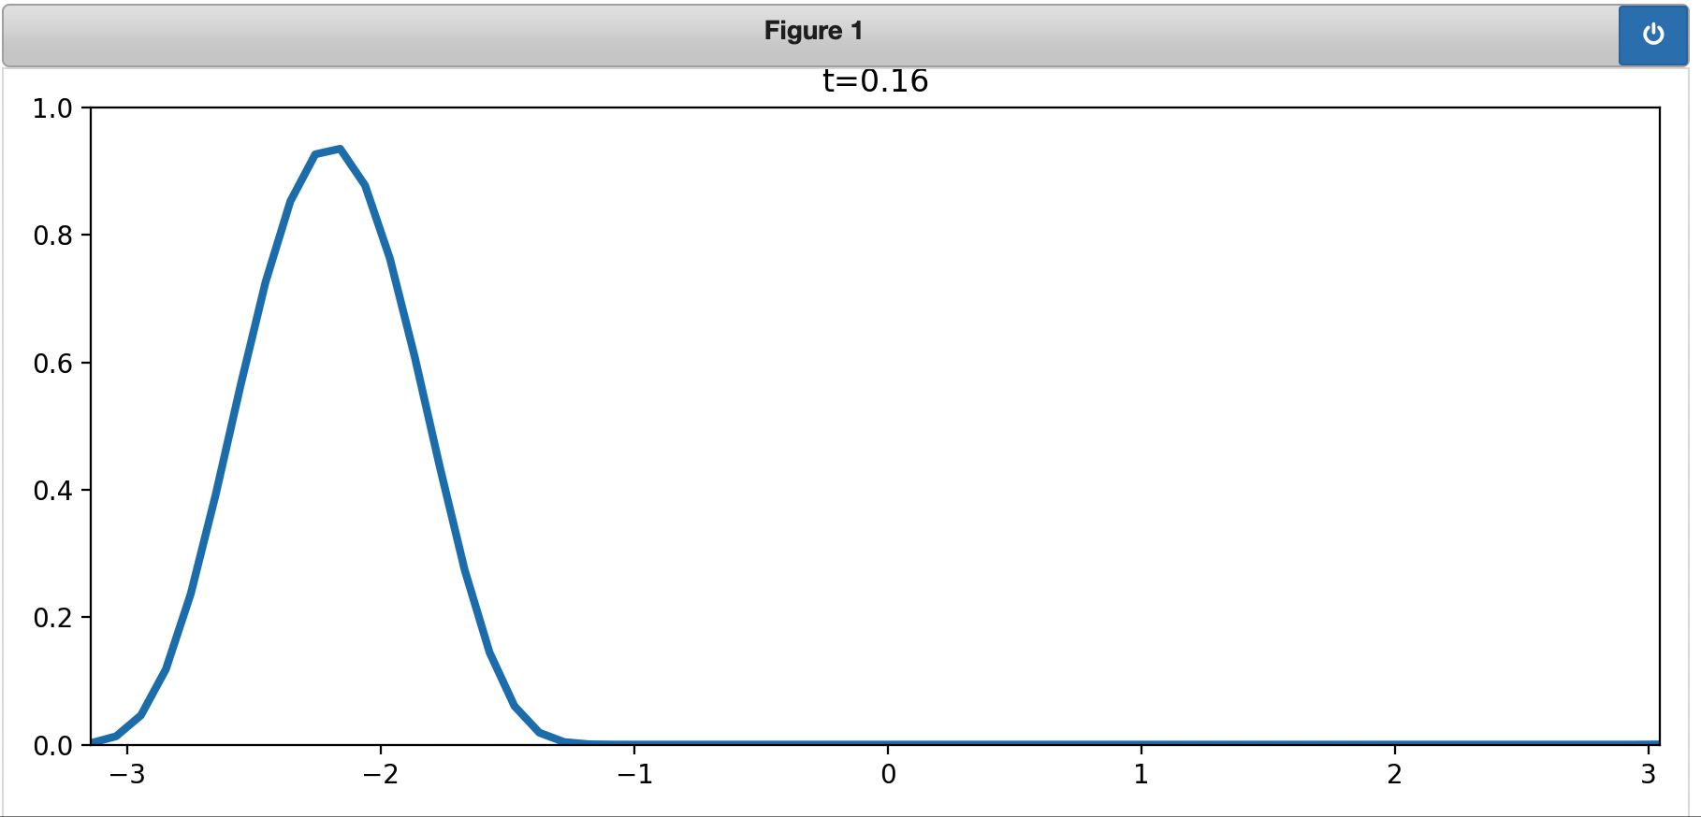
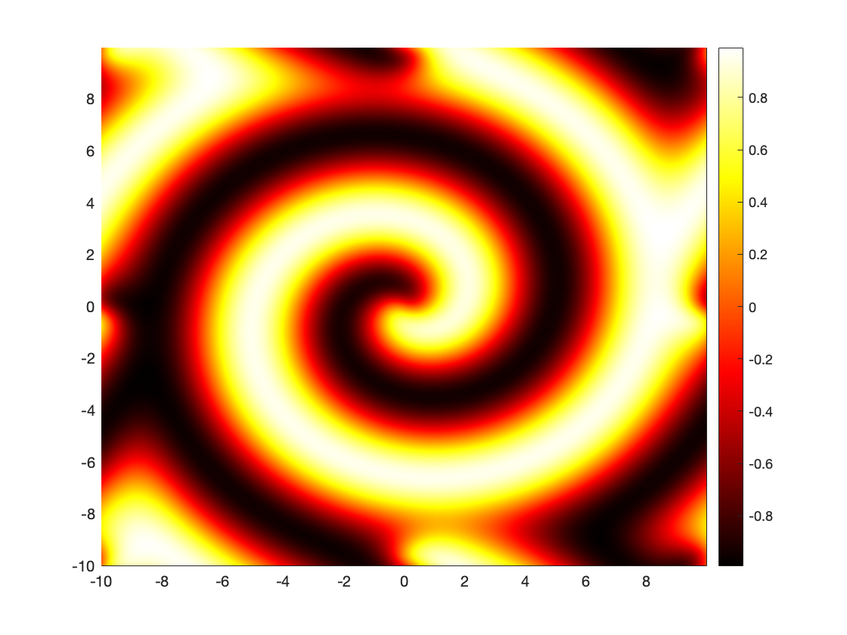
Phase 3(in progress): Wave Analysis
The goal of phase 3 is to use SciML framework to identify the dynamics of nonlinear waves and do simulations depending on the situation.
Some of the work can be used in the bounty hunter project for wavelet decomposition or simulation
Advective & Diffusive Waves:
Represent the density or concentration of some substance and how the energy, particles, or some other physical quantity is transferred in a physical system through two processes: diffusion and advection.
Notes:
Solutions computed & simulated through the use of PDE-FIND and PySINDy libraries
Reaction Diffusion:
These equations arise naturally in systems consisting of many interacting components, (e.g., chemical reactions) and are widely used to describe the change in space and time of the concentration of one or more chemical substances, and how they are transformed into each other, and diffusion which causes the substances to spread out over a surface in space.
The above reaction yields a spiral wave to form.
There are many applications to this due to how broad it is, a few are
Population growth (can be exponential, logistic)
Predator-prey model - predator population Y eats the prey population X
Competition – two species compete for food, outcome yields a diffusive pattern in one population
https://www-m6.ma.tum.de/~kuttler/script_reaktdiff.pdf

Slide 8
So… Why?
Data driven discovery of governing phenomena is essential for modeling, simulating, predicting, and controlling complex systems.
Modern methods are able to tackle problems in the aforementioned fields very easily.
Plug in data, get the power to simulate the system in conditions which would otherwise be tough
Who is Interested: DARPA, CIA, Army Research Office, Air Force Office of Scientific Research, AF Research Lab, Dept. of Energy, NSF, Boeing, Lockheed, Raytheon... Etc.
Notes:
Machine learning, applied physics & math is key to integrate modeling & controlling dynamic systems.
Fluid dynamics, neuroscience, climate, epidemiology, finance, robotics and autonomy are all dependent on control theory.
Ex: Navier Stokes – modeling weather, pressure, electro/magnetodynamics, air-flow on a wing, etc

Slide 9
Overall Internship
Learned about SciML – I wouldn’t have known of this field otherwise
I study physics & love computers – SciML is a match made in heaven
Learned about nonlinear dynamic systems, modeling the systems, and simulating the systems
Rigorous application of machine learning – I’ve never made a physics informed neural network, making 3 of them and fine tuning them was awesome
Plugged into the latest technologies & frameworks, reading about new research and following the innovation
Constant learning of MLOps & Dev Ops – Something not taught in school, only learned through work experience
Met incredible folks here – 100% accurate statement that COLSA is a family of professionals
The wave analysis & implementation of PDE-FIND/PySINDy libraries could be integrated into bounty hunter to ease some of the data wrangling and model discovery
The SciML work could potentially be a marketable product where these sorts of engineering support services could be offered for control & optimization purposes.
Thank you for the opportunity

Slide 10
Questions?

